Slide 1
Navigating Possibilities with Great Rewards- We want to serve your student!
Tish Harris Caroline Rammacher

Slide 2
Our Vision: Shaping Futures, Bridging Dreams
Our mission is to empower transition students to succeed by connecting them with meaningful opportunities to build friendships and community, explore careers, grow mentors, and develop essential skills for lifelong success.

Slide 3
DBVI Student Team Programs began..
11 years ago-developed from CPID grant funding in partnership with DARS for career pathways
Post grant- DBVI continued to focus on innovation and connection
One person on student team in the beginning, then 2, then 3 now 4!
Student Team has a counselor relations specialist-welcome Caroline
Caroline and Tish are happy to meet with students
Notes:
Tish will cover

Slide 4
Numbers Comparison 2017-2025
2017- Center Traditional Programs
Offered 2 programs
Total of 30 Students served
2024 Student Team Programs Accessed
Offered 23 programs
Total of 564 programs accessed
2025
2026
25 Programs offered- diverse interests and abilities
27 Programs offered
Total of 516 programs accessed
Notes:
We'll get back to you on how many programs done in 2026
Encourage people to come to our next session to learn more about specific programs

Slide 5
Goal of Student Team Programs:
Increase confidence
Increase connection
Create community
Create engagement
Provide 5 Required Pre-ETS Services in the most energetic way possible!
Notes:
Caroline talk about 5-required pre-ets in laymans/education terms and examples

Slide 6
Increase Confidence
Actions Change Attitudes
Overcome Underestimation
Deliver programs that encourage stepping outside your comfort zone:
What else can I do?
What problem can I solve?
What are my superpowers?
Notes:
Tish covers

Slide 7
Video: Unstoppable

Slide 8
Increase Student Connection
Awareness of Resources
Inside DBVI
Stronger connection to VR Counselors, ED Coordinators
Stronger engagement with the Student Team
Inside School
Connection to and appreciation of Teachers of the Vision Impaired
Stronger connection with teachers
Circle of Trust
How to advocate within the circle for needed resources
Outside Resources
I’m Determined
PEATC
Lions Club
Mentors
Employers and industry leaders
Peer mentors
Student Team has outreach specialists that will meet with you and do community events.

Slide 9
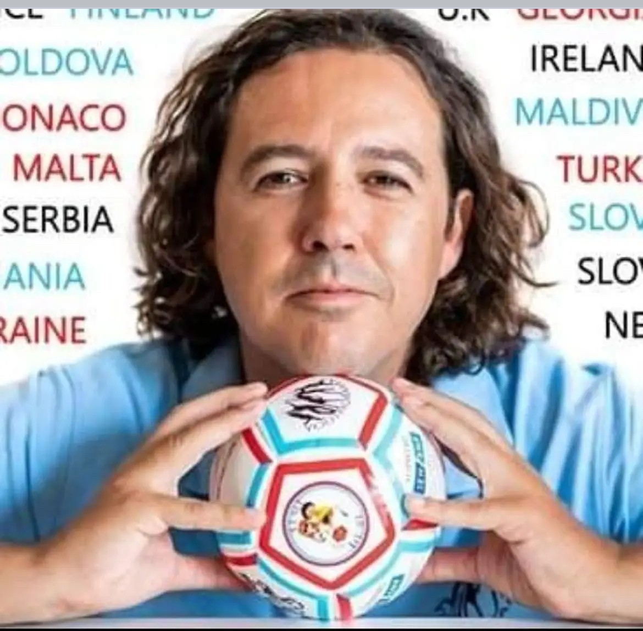
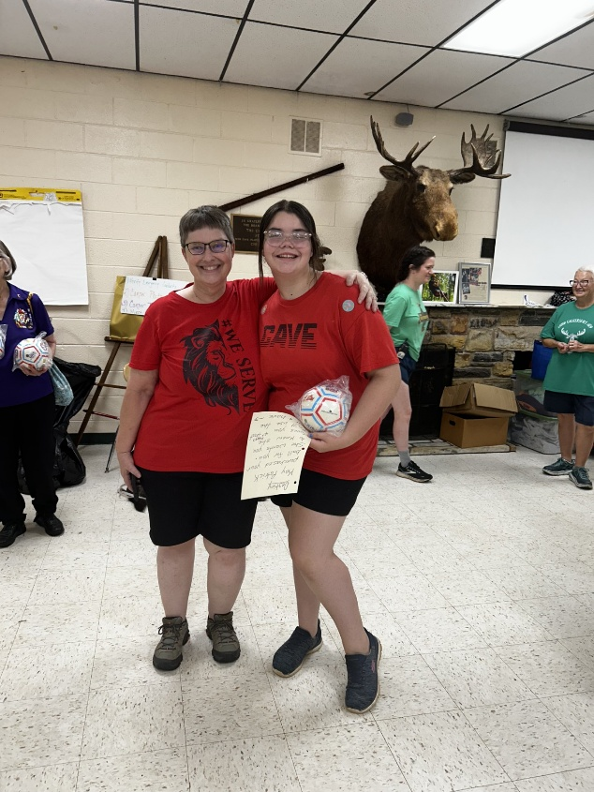

Slide 10
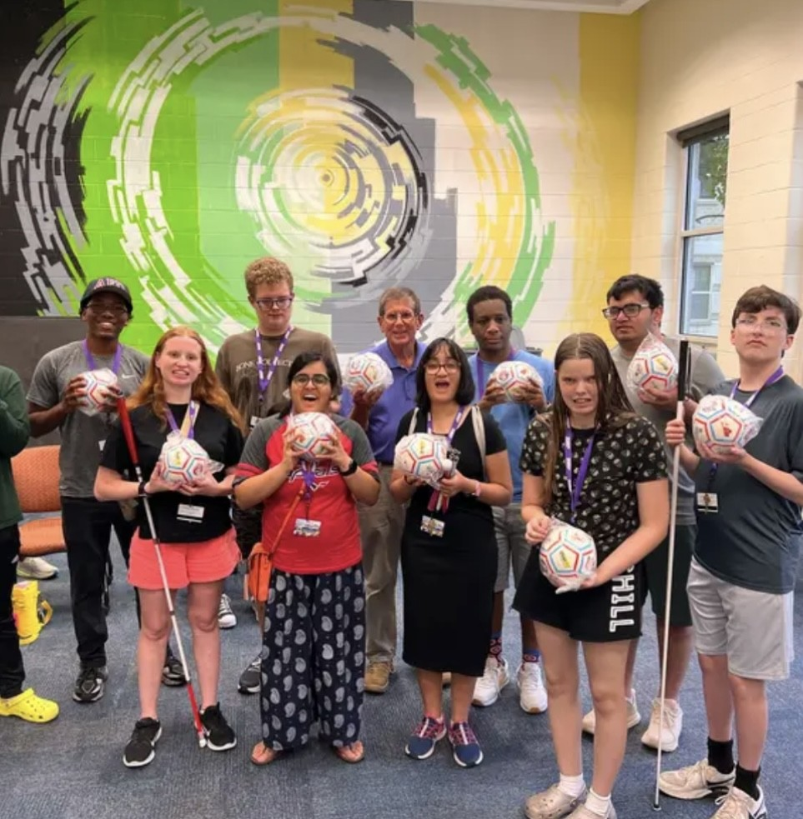


Slide 11
Create Community
Students Find friends
“Just like me”- Luke’s story
Social development
Parents find a community
Lived Experience
Shared Expertise

Slide 12
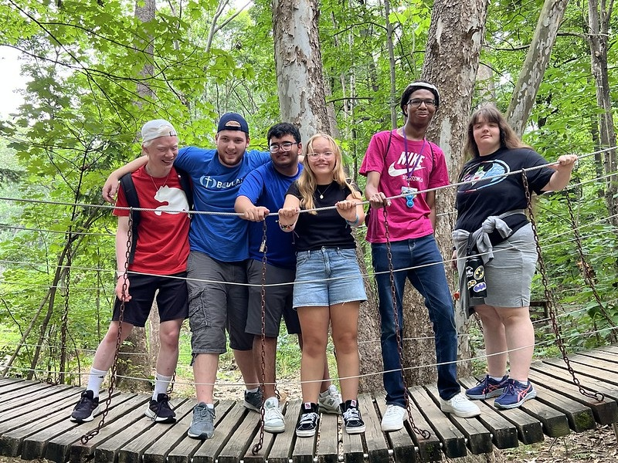

Slide 13
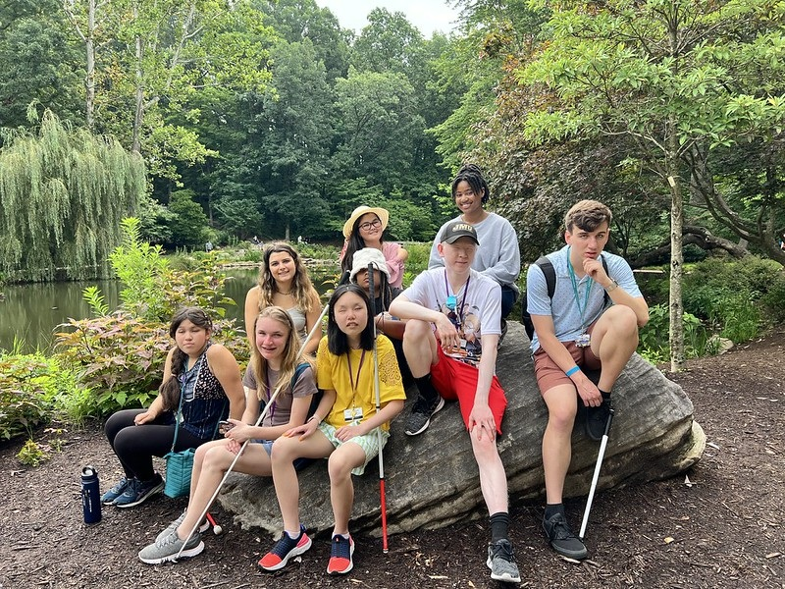

Slide 14
Parent video!

Slide 15
Create Engagement
Engagement with Current Opportunities
Looking into the Future
Being Present
Engaging with Professionals outside of the Vision Community
College professors, tech experts, teachers
Artists, musicians,
Paralympians and world medal athletes
Customer Service and Communication leaders
Notes:
Helping Students Connect, Explore, and Grow
Engage with Current Opportunities:
Participate in programs, activities, and events happening now.
Build confidence through hands-on experiences.
Look Into the Future:
Career exploration and skill-building for long-term success.
Discover pathways that align with passions and strengths.
Be Present & Communicate:
Learn to engage meaningfully with peers and mentors.
Practice collaboration and effective communication.
Expand Horizons Beyond the Vision Community:
Work with college professors, tech experts, teachers, artists, musicians, Paralympians, and world medal athletes.
See possibilities through others’ eyes and experiences.
Why It Matters:
Exposure to diverse perspectives sparks creativity and ambition.
Engagement builds networks, confidence, and real-world readiness.

Slide 16
Making it Happen!
Leadership Support
Innovative Out of the Box Thinking
Our challenge for you: Which of your students could use a dose of confidence, a new experience to build skills, or just fun?

Slide 17
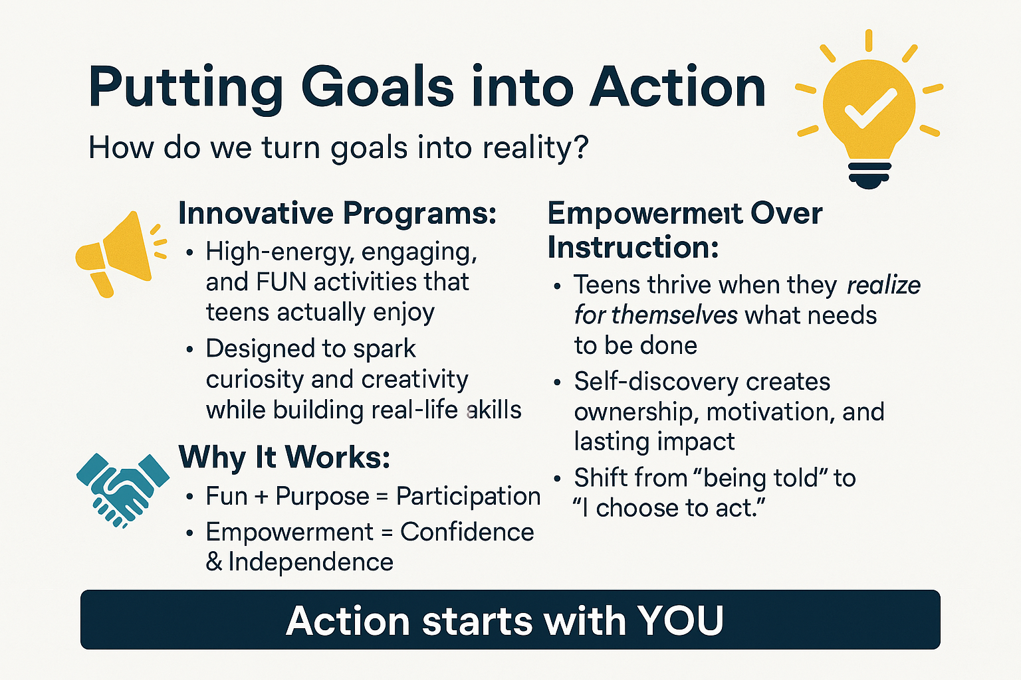
Notes:
People want to come! Rich sign and Heidi falling down steps

Slide 18
Our message to students
Growth is uncomfortable because you’ve never been here before.
Breaking tradition means breaking limits.
Tradition is safe. Innovation demands courage.
You have a team and resources to walk along side you!

Slide 19
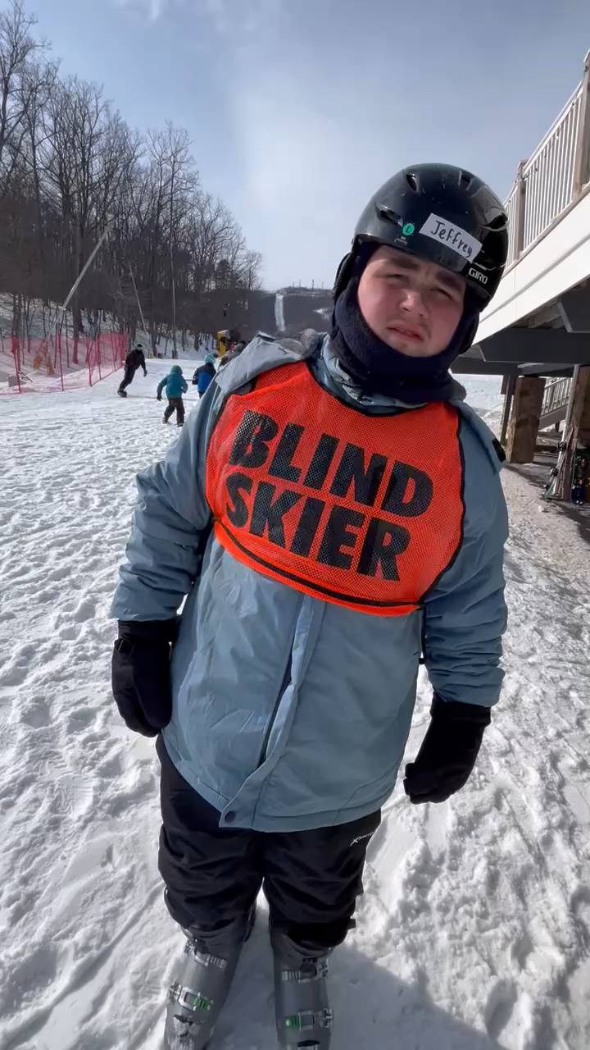
First time skier!

Slide 20
Does it work? YES!
The students show it
The numbers prove it

Slide 21
Hear it from a parent!
Notes:
Video on how students show it's working!

Slide 22
The Numbers Show it: Historical Data
First DBVI student program under CPID grant was Robotics
began planning in 2016- first program presented in 2017 was Robotics
In 2017 traditional student program attendance was 23 for LIFE and 7 for LEAP College Readiness Program

Slide 23
Do Student Team programs work?
Average Measurable Skills Gains from NCSAB-
2017
30%
PY 22
93%
PY 21
85%
PY 23
PY 24
86% #1 among blind agencies in US
86% #1 among blind agencies in US
PY 25
86.4%
SD In second at 72.9
Credential Attainment- #1 at 75.7%

Slide 24
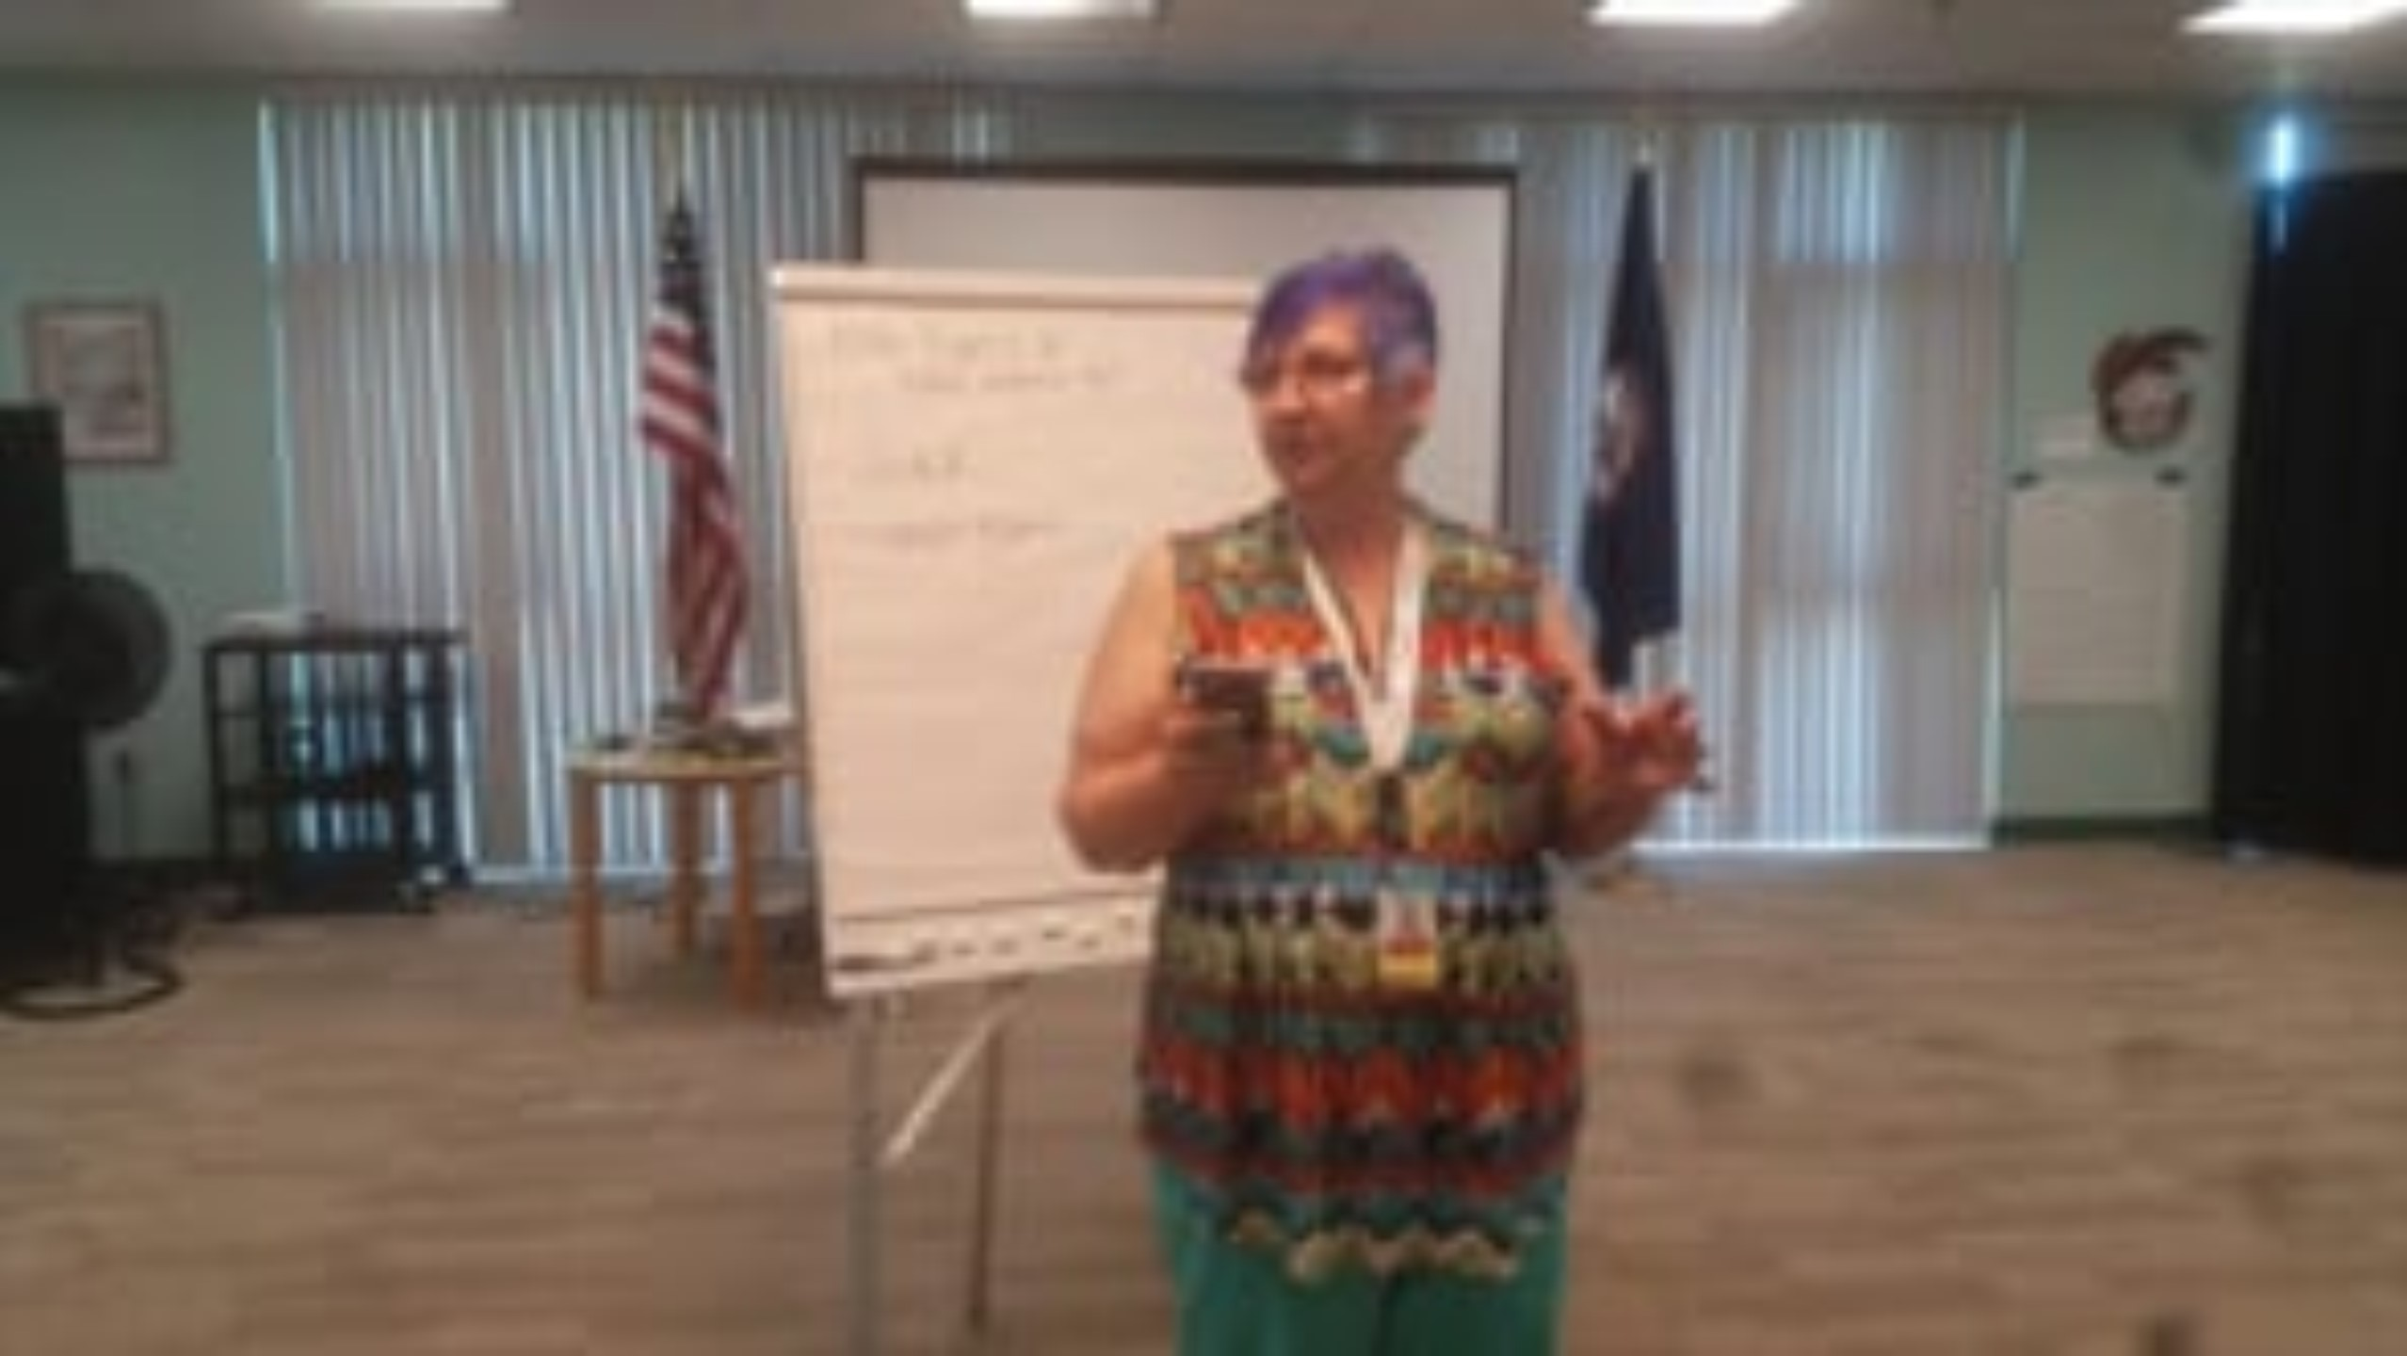
The Power of Trying Something New!

Slide 25
Have you seen rewards among your students?
Have Questions?
Want to connect?
We are happy to meet with your students after hours or whenever needed!
Tish.Harris@dbvi.virginia.gov
Caroline.Rammacher@dbvi.virginia.gov

